Slide 1
Spelling

Slide 2
Aims:
The difficulty with spelling
How we teach and support children to spell
How you can support your child at home
https://www.youtube.com/watch?v=ObkJNstaog8

Slide 3
Different letters make different sounds…
Different combinations of letters make the same sound e.g. ea ee y ie
The same letter can make different sounds…
e.g. i – history bicycle
Dialect, upbringing, colloquialisms

Slide 4
How many ways of spelling the ‘igh’ sound can you find?
There are more than ten!
igh y i-e ie is i ais eigh
y-e ye ae ai ia eye ay ei

Slide 5
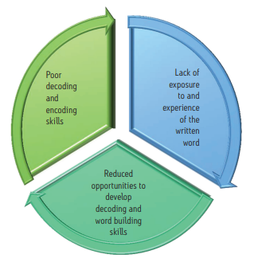

Slide 6
Error proportion:
Sound : meaning : visual
3 : 1 : 2
Notes:
Infants examples e.g. thire / fire. Over / other

Slide 7
How do you spell butterfly?
Notes:
Graphemes are the written units that represent the sound.

Slide 9
How will we achieve this?
Weekly spelling lesson 20-30 minutes
Teach spelling objectives as outlined.
Use different activities to practise the rule.
Morphology (splitting words into root word, prefixes and suffixes).
Personalised spelling practice
Children have a spelling book to record words that the teacher has corrected or that are new to them e.g. from a book / topic work.
Practise independently or with a partner.
Notes:
Spelling corrections in books.

Slide 10
 | Year 3 | Year 4 | Year 5 | Year 6
Spring 2 | Making plurals by adding es /u/ sound spelt ‘ou’ Super-, anti-, auto- as a prefix Apostrophes for contractions Apostrophes for possession Homophones | Plural possessive apostrophes /zhuh/ sound spelt with ‘sure’ (treasure) /chuh/ sound spelt with ‘ture’ (picture) /shuhn/ sound spelt with ‘sion’ and ‘tion’ /shuhn/ sound spelt with ‘ssion’ /shuhn/ sound spelt with ‘cian’ (musician) | Words with an /or/ sound spelt ‘or’ Words with /or/ sound spelt ‘au’ Convert nouns or adjectives into verbs using the suffix -ate Convert nouns or adjectives into verbs using the suffix -ise Convert nouns or adjectives into verbs using the suffix -ify | Etymology – words with Greek prefixes Etymology – words with Greek prefixes Words ending with –ible or –able Words ending with -ibly or -ably Revision of spelling words

Slide 11
Half termly curriculum overviews show the spelling rules for that term
https://www.heatherside-jun.hants.sch.uk/page/?title=Year+5+Curriculum+Maps&pid=44

Slide 12
Notes:
What’s the tricky part? How else could we spell it?

Slide 13
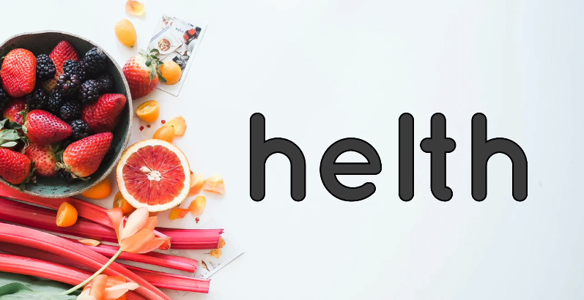
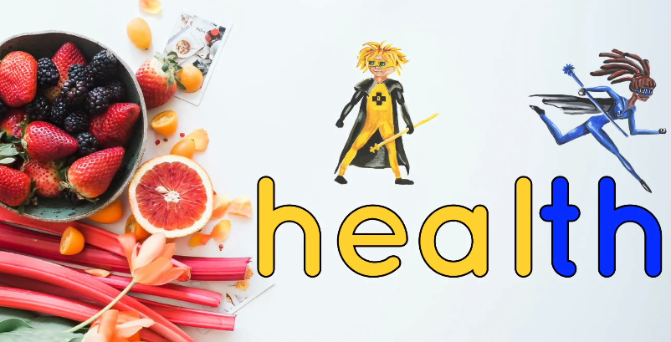

Slide 14
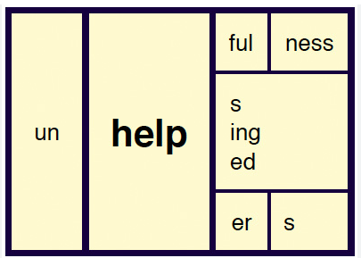
Prefix
Root Word
Suffix

Slide 15
Summary of how we teach spelling in school…
Rules and structure of words
rather than
just tests

Slide 16
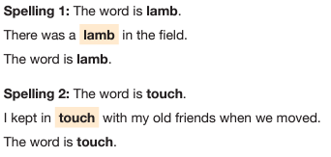
Year 6 SATs Spelling Test
20 words Dictated to the class

Slide 17
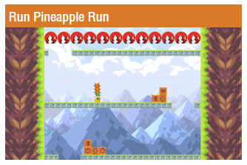
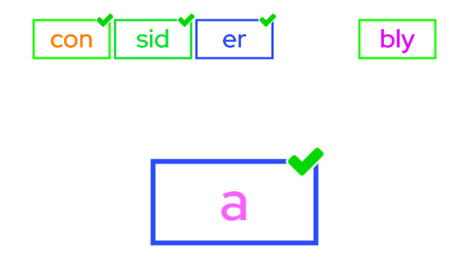
https://spellingframe.co.uk/

Slide 18
How can I help my child with spelling?
1. Always ask your child to have a go.
2. What is the first sound?
3. Can we break it down into sounds or syllables?
4. Which bit in the word is hard?
5. Do we know any other words like this?

Slide 20
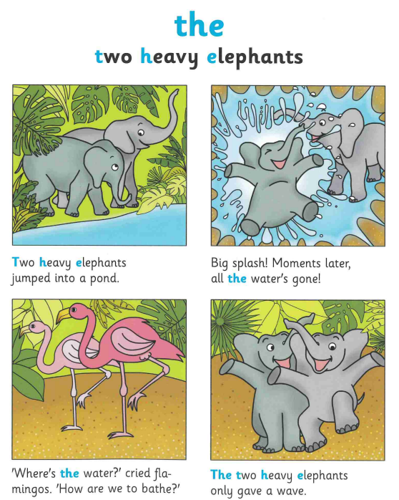

Slide 21
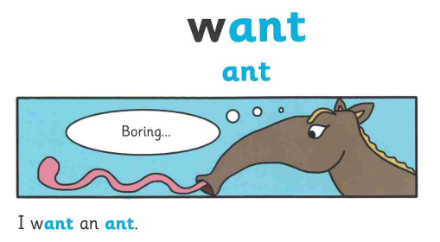

Slide 22
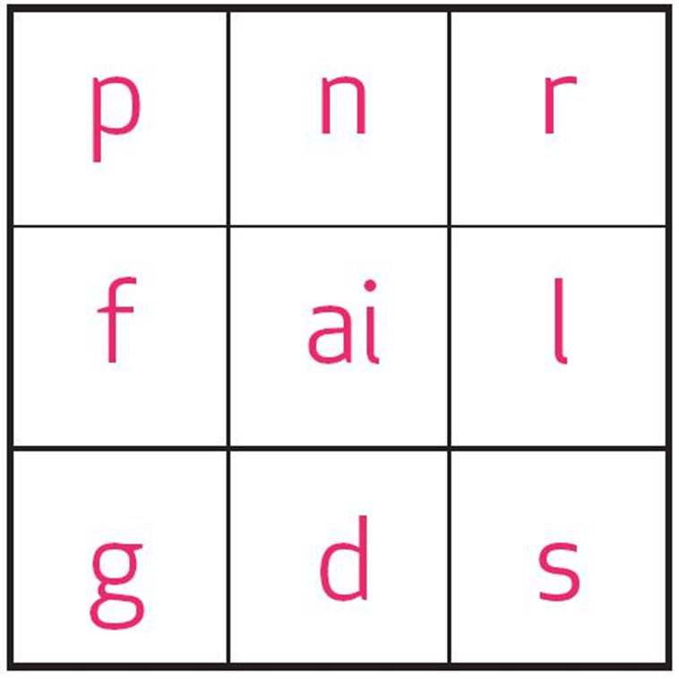
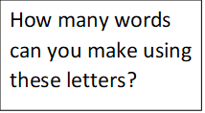

Slide 23
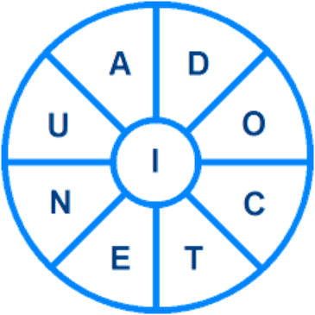
How many words can you make from the letters in the wheel? Each word must contain the hub letter I.
Can you find a 9-letter word and at least 20 other words of five letters or more avoiding proper nouns?

Slide 24
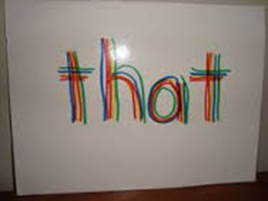
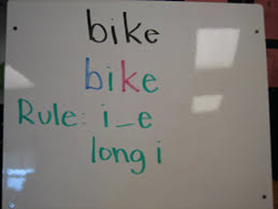
Children ‘colour chunk’ their spellings in a way that is memorable to them, this could be done phonetically, using syllables, or colour coding the suffixes or prefixes. Some children like to go over their spellings in many colours.

Slide 25
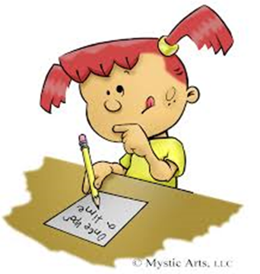
Ask children to write a story containing the spelling words or sound that they are learning.
This could be a nonsense/silly story that is totally made up, but by putting the spellings being learnt into a context some children will find them easier to learn.

Slide 27
