Slide 1
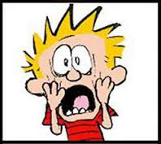
Supporting your Anxious Child

Slide 2
Its not that I don’t think she should worry about getting her homework in on time, but she just seems to go over the top.
‘What if’ seems to be his favourite phrase!
Her response just doesn’t seem rational. When has a spider ever killed someone in this country.
She won’t try new things…clubs and activities are a no, no.
Birthday parties are the worst, I struggle to persuade him to go and then he insists on me staying.
I really struggle to calm her down because I’m so frustrated and so it all just gets worse.

Slide 3

What we will look at today:
What is anxiety
How thoughts, feelings and beliefs impact behaviour
How we can influence that as parents
Unhelpful/helpful ways to deal with anxiety

Slide 4

What is anxiety?

Slide 5

Physiology of anxiety: what do you see in your child?
Dizzy Light headed
can’t concentrate
Tunnel vision
Difficulty swallowing / dry mouth
Difficulty breathing
Heart pounding
Tightness in chest
Butterflies in stomach
Sweating, nausea, diarrhoea
Need to go to toilet
Trembling / shaking

Slide 6
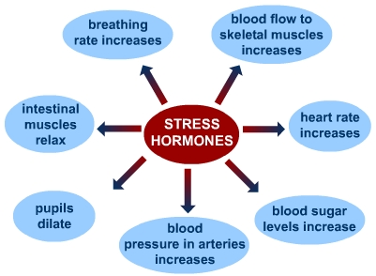
Why is there a physical response?
So we can stand and fight or run away!
Its important our bodies react in this way so we can deal with threats but sometimes our brains incorrectly perceive something as a threat and we react in this way to things that are not actually going to cause harm.
Normalise

Slide 7
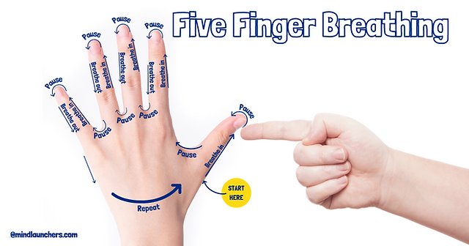
Managing those symptoms:
Controlled Breathing
When we control our breathing the brain sends signals to the body to stop releasing the adrenalin and that helps us to become calm:-

Slide 8
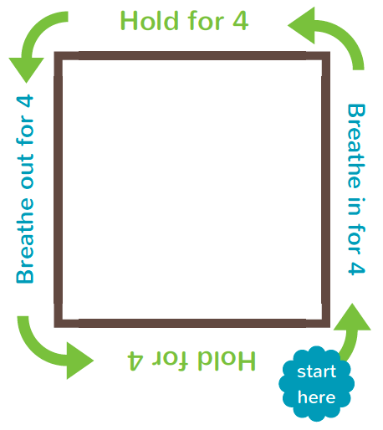
Square or box breathing

Slide 9
Why is my child anxious?
Genes
Negative thoughts
Avoiding
Parent reaction
Parent modelling
Stressors

Slide 10
My child’s anxiety
Social fears
Separation fears
Generalised fears
Obsessive compulsive fears
Physical symptoms
Panic fears
Post traumatic fears
Specific fears

Slide 11
(The Cognitive Behaviour Cycle)
Dogs are dangerous and the way to stay safe is to avoid them.
Thoughts
Dogs are dangerous.
Don’t go places there might be a dog.
Behaviour
Feelings
Run away from dog/avoid dog.
I feel scared and frightened.
I am terrified of dogs.

Slide 12
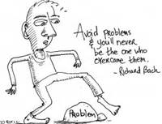
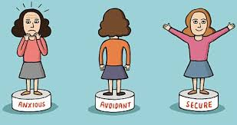
…and if we help our children avoid problems we are not supporting them in overcoming them independently.

Slide 13
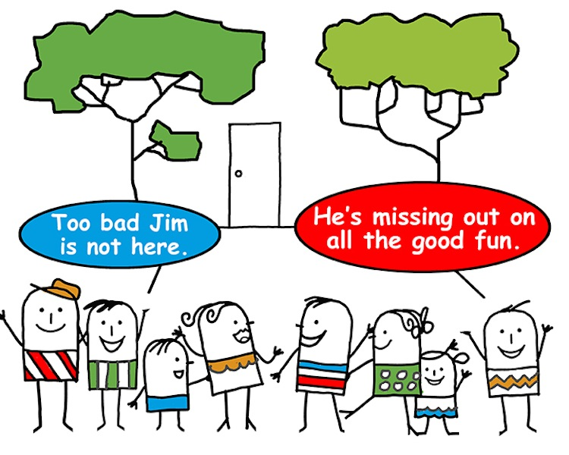
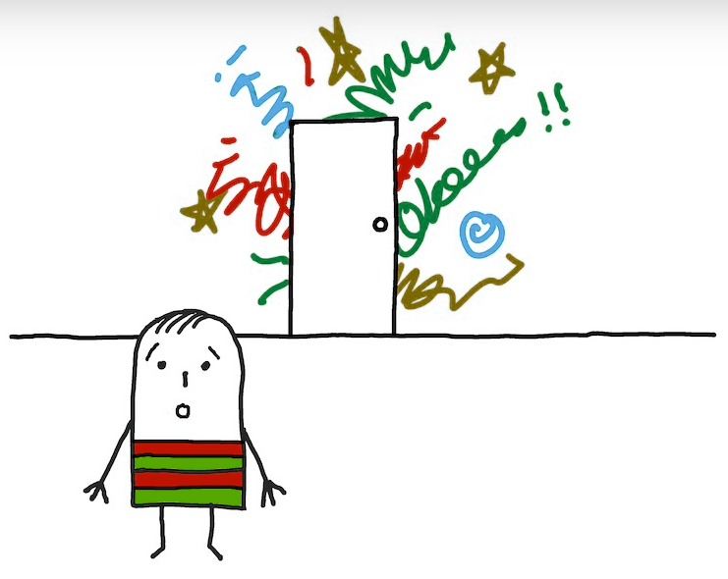
Notes:
.

Slide 14
How adults can influence this cycle?
Thoughts
Behaviour
Feelings
I don’t want to go to school.
I am worrying about going swimming for PE.

Slide 15
Unhelpful support:
Excessive reassurance
Being too involved
Being too directive
Permitting avoidance
Becoming impatient
We need to do less of these.

Slide 16
Helpful support:
Reward brave/non-anxious behaviour
Plan to ignore behaviours you don’t want
Promoting your child to cope constructively
Model brave/non-anxious behaviour
We need to do more of these.

Slide 17
A few tools to highlight:
Communicate - scale
Muscle Relaxation
Distractions and Calm Mind
Thought Detective

Slide 18
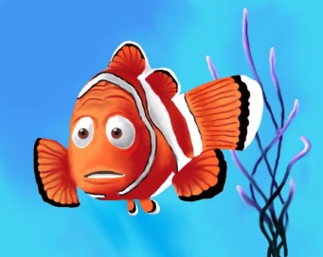
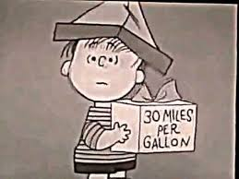
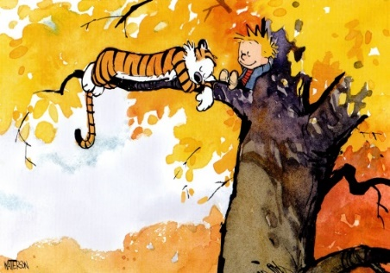
The worry scale:
10 - Extremely worried
9
8 - Very worried
7
6 - Worried
5
4 - A bit worried
3
2 - Not sure
1
0 – Very relaxed

Slide 19
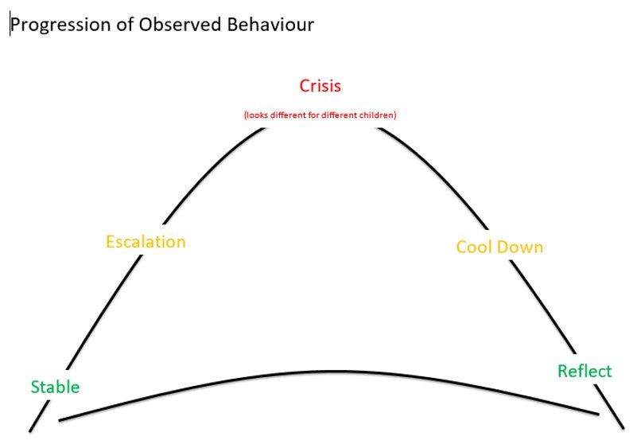

Slide 20
A few tools to highlight:
Communicate - scale
Muscle Relaxation
Distractions and Calm Mind
Thought Detective/Challenge

Slide 21
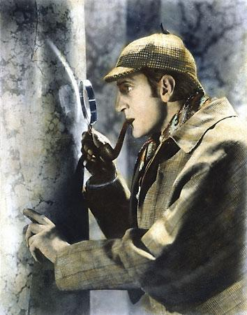
Parenting the anxious child:
Detective thinking
What are my current strategies?
Do these work?

Slide 22
Fact or thought?
Challenge with facts
Ask what evidence they have for that statement
Scenario A vs B
When has that happened before…how many times?
What happened last time?
What is the worst thing that can happen.
X is gonna happen.
I have no friends
Mrs X hates me.
I can’t do maths.
They all think I am …

Slide 23
Principles to remember:
Be consistent
Keep your own emotions in check
Distinguish between misbehaviour and anxious behaviour
Manage misbehaviour
Remove privileges if necessary
Natural consequences

Slide 24
Kate Williams
Kathryn.Williams@court-moor.hants.sc.uk
01252 615065 ext 296

