Slide 1
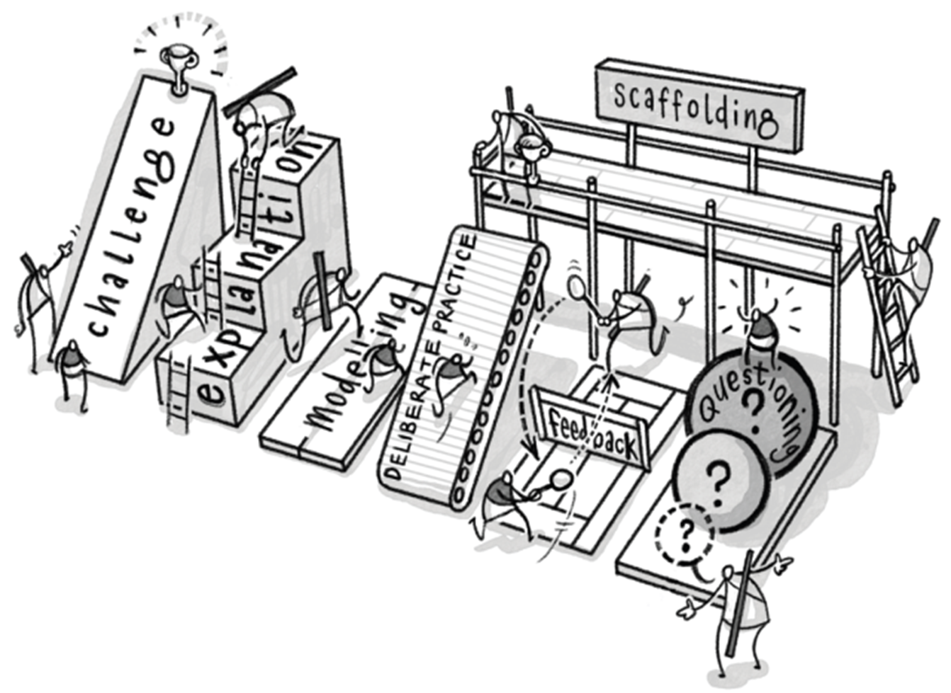
Mathematics
Monday 9th March
Focus:
Getting to grips with pencil and paper methods
for the four number operations

Slide 2
National Curriculum:
addition & subtraction
Year 3:
Add and subtract numbers with up to 3 digits, using formal written methods of column addition & subtraction.
Year 4:
Add and subtract numbers with up to 4 digits, using the formal written methods of column addition & subtraction.

Slide 3
Vocabulary
Addition:
add plus sum
total combine
altogether
more than
increase by
Parts of addition
3 + 2 = 5
addend
addend
sum or
total
operator

Slide 4
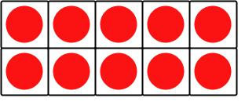
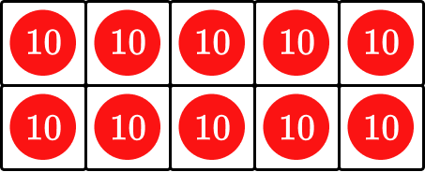
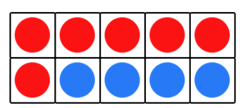
How can I help my child?
Knowing their number bonds
Number bonds to 10 and then 20 and the related subtractions bonds.
For example:
160 + 40 = 120
40 + 160 = 120
200 – 40 = 160
200 – 160 = 40
For example:
16 + 4 = 20
4 + 16 = 20
20 – 4 = 16
20 – 16 = 4
20
200
16
40
160
4
10
10
10
10

Slide 5


By the end of Year 3,
children are expected to be able to:
add numbers with up to 3-digits, using formal column addition.
For example: 161 + 32 =
32
161
+ 32
193
Children will start with using column addition without carrying
30
2
Notes:
Explain that we would start with smaller numbers, then work through the example. Highlight the fact that we wouldn’t use column headings as this would suggest eg 30 tens, not 30.

Slide 6
Children are then expected to be able to add up to two 3-digit numbers
using compact column method with carrying.
For example: 258 + 136 =
Children are also expected to be able to estimate the answer to a calculation and use the inverse operation to check their answers.
H T U
258
+ 136
394
1
Notes:
Add units first, explaining the carrying of the 10 (stressing that this is placed at the top of the column at this stage.

Slide 7
From Year 4, children will then use the compact column method to add 2 or more numbers, using place value indicators alongside concrete apparatus and other visual models.
For example: 325 + 243 =
H T U
3 2 5
+ 2 4 3
5 6 8
Notes:
Initially this is without carrying.

Slide 8
Once secure with concrete apparatus and other visual models, children will then use the compact method to add four-digit numbers with carrying.
For example: 2,286 + 1,147 =
Th H T U
2,2 8 6
+ 1,1 4 7
,
3
4
3
3
1
1
In the context of money and measures, including decimals.
In Year 5, children will move on to adding numbers with more than four digits.
.
Notes:
Note that the carried digit is now underneath, rather than on top of the numbers.

Slide 9
Vocabulary
Subtraction:
minus subtract
take away deduct
fewer than less than
difference between
decrease by
Parts of subtraction
5 - 2 = 3
minuend
subtrahend
operator
difference

Slide 10
By the end of Year 3,
children are expected to be able to:
subtract with numbers up to 3-digits.
For example: 187 - 35 =
Children will start with using column subtraction without exchanging
187
- 35
152
Notes:
Explain the use of ‘and’ and the + sign and stress not using place value headings on columns.

Slide 11

Children are then expected to be able to subtract up to two 3-digit numbers by partitioning in columns with exchanging.
For example:
43 – 27=
Children will be taught that in order to subtract 7 from 3 it is necessary to exchange ten and add it to the 3 to make 13.
30 13
40 and 3
- 20 and 7
10 and 6 = 16
Notes:
Teacher may do it differently: 43-27 43-20=23 23-7=16

Slide 12
In Year 4, children will then use the compact column method to subtract 2 numbers, using place value indicators without exchanging.
For example: 278 - 145 =
H T U
2 7 8
- 1 4 5
1 3 3
Notes:
Initially this is without carrying.

Slide 13
Children will then use the compact method
to subtract two numbers, using place value indicators with exchanging.
For example: 267 - 149=
H T U
5
2 6 7
- 1 4 9
1 1 8
1
Notes:
Initially this is without carrying.

Slide 14


The compact column method is then extended to 4-digit numbers with exchanging across more than one place value column, including where there is a 0 in the top number.
For example: 2404 - 1146 =
Th H T U
2, 4 0 4
- 1, 1 4 6
1, 2 5 8
3
9
1
In Year 5, children will subtract numbers with more than four digits, including decimals.

Slide 15
Vocabulary
Multiplication:
multiply times
twice double triple
groups of
product
multiplied by
Parts of multiplication
5 x 3 = 15
factor
factor
operator
product

Slide 16
It is essential that children have a fluent recall of multiplication facts and their related division facts:
By the end of Year 2 children are expected to recall facts for the:
2, 5 and 10 x tables
By the end of Year 3 children are expected to recall facts for the:
3, 4 and 8 x tables
By the end of Year 4 children are expected to recall facts for:
all tables up to 12 x 12
In June, children in Year 4 will take the national on-line multiplication tables check, consisting of 25 questions. They will have 6 seconds to answer each question.

Slide 17
How can I help my child?
Making connections
Chanting tables is only part of committing multiplication facts to memory as they have the disadvantage of keeping calculations such as 3 x 5 and 5 x 3 separate.
Learning the multiplication facts strategically
helps children to make connections and
reduces the burden on their working memory.

Slide 18
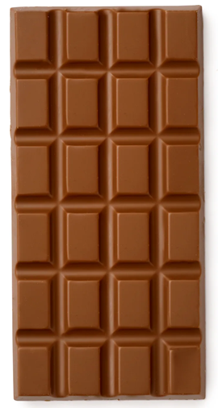
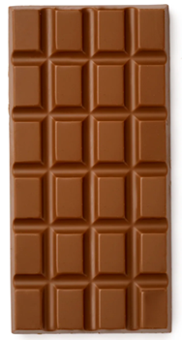
Commutative Law: the old switcheroo
The commutative law is the easiest for children to understand: what are sometimes call ‘switchers’.
a × b = b × a
4 x 6 = 24
6 x 4 = 24

Slide 19
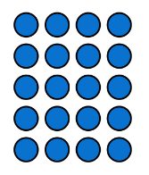

Triple Whammy: fact families
Know one fact get three facts free!
5 x 4 = 20
4 x 5 = 20
20 ÷ 4 = 5
20 ÷ 5 = 4
20
4 | 4 |  | 4 |  | 4 |  | 4
5 |  | 5 |  | 5 |  | 5

Slide 20



Distributive Law
The rule that says that multiplication distributes over addition.
6 x 7 = 42
(3 x 7) + (3 x 7) = 42

Slide 21
National Curriculum: multiplication
Year 3:
Write and calculate mathematical statements for multiplication using the multiplication tables they know, including for 2-digit numbers times 1-digit numbers, using mental and progressing to formal written methods.
Year 4:
Multiply 2-digit and 3-digit numbers by a 1-digit number using formal
written layout.

Slide 22
Year Three: The Grid Method for TU x U
X | 20 | 3
8 | 160 | 24
23 x 8 =
8 x 23 = 184
160 + 24 = 184
This is extended to
a 3-digit x 1-digit number, using the grid method.
The numbers are partitioned and placed in a grid.
The individual answers are added together in order to calculate the final answer.

Slide 23
Expanded Column Method for TU x U
For example:
5 x 56 =
56 x 5 =
56
x 5
30 (5x6)
250 (5x50)
280
Used alongside:
concrete apparatus
visual models
informal jottings

Slide 24
COMPACT COLUMN METHOD
For example: 23 x 3 =
23
x 3
69
This is then extended to
carrying across columns
and to using 3-digit numbers.
138
x 7
966
2 5
By the end of Year 4,
children should be able to
use the compact method
for TU x U and HTU x U
In Year 5, children should
be able to use the compact
method for ThHTU x U
Notes:
Slide 8
The question appears, then the method. The final answer on the left has to be clicked on by the mouse.

Slide 25
National Curriculum: division
Year 3:
write and calculate mathematical statements for division using the multiplication tables that they know … using mental and progressing to formal written methods.
Year 4:
Use place value, known and derived facts to divide mentally, including dividing by 1.

Slide 26
Vocabulary
Division:
divide
halve quarter
equally groups
divided by shared by
remainder
Parts of division
15 ÷ 5 = 3
dividend
divisor
operator
quotient

Slide 27
Year 3 into Year 4
Children will use known facts to divide a 2-digit number by a 1-digit number
25 ÷ 5 = 5
…and derive related facts.
60 ÷ 3 = 20
can be derived from 6 ÷ 3 = 2
Children will also use known facts to identify missing numbers.
8 ÷ = 2
4

Slide 28
Year Four
Children will extend this to 3-digit numbers facts, such as:
by 10 and 100.
If 6 ÷ 2 = 3 then 600 ÷ 2 = 300
They will use the formal written method for short division.
In Year 5, they will divide up to 4-digit numbers by a 1-digit number using the formal written method of short division and interpret remainders for the context.

