Slide 1
Year 4 residential to Osmington Bay adventure centre
19th April – 21st April 2027
Shortlake Ln
Osmington
Weymouth
DT3 6EG

Slide 2
Year 4 residential to Osmington Bay adventure centre
Day 1 – Monday 19th April
We leave at 8.00am on Monday morning. Our first stop will be Durdle Door to look at coastal formations. Here we eat our packed lunch and then we head on to Osmington Bay.

Slide 3
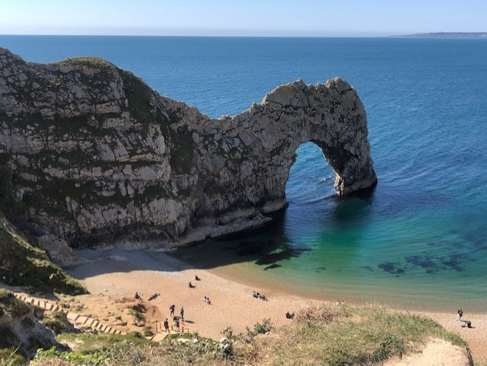
Durdle Door
Notes:
Our focus on this trip is on our Geography syllabus. On firstday, we visit Durdle door and Lulworth Cove where the children learn about coastal erosion and coastal landforms. We will also consider the differing habitats on the downs, coastal cliffs and beach. There is quite a walk to and from Durdle Door, which all the children did brilliantly with earlier this year as well as many stairs down to Lulworth Cove. Thankfully we don’t need to walk back up them!

Slide 4
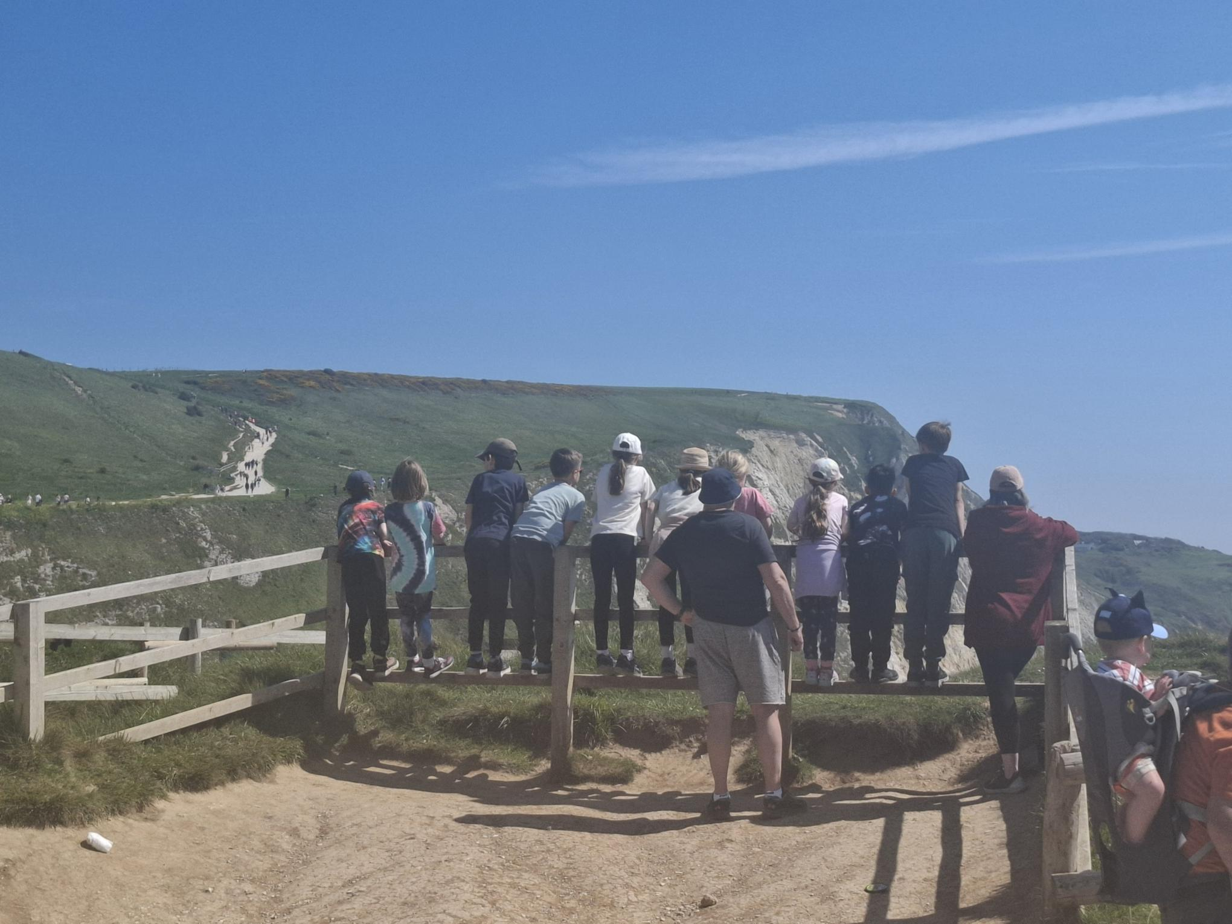
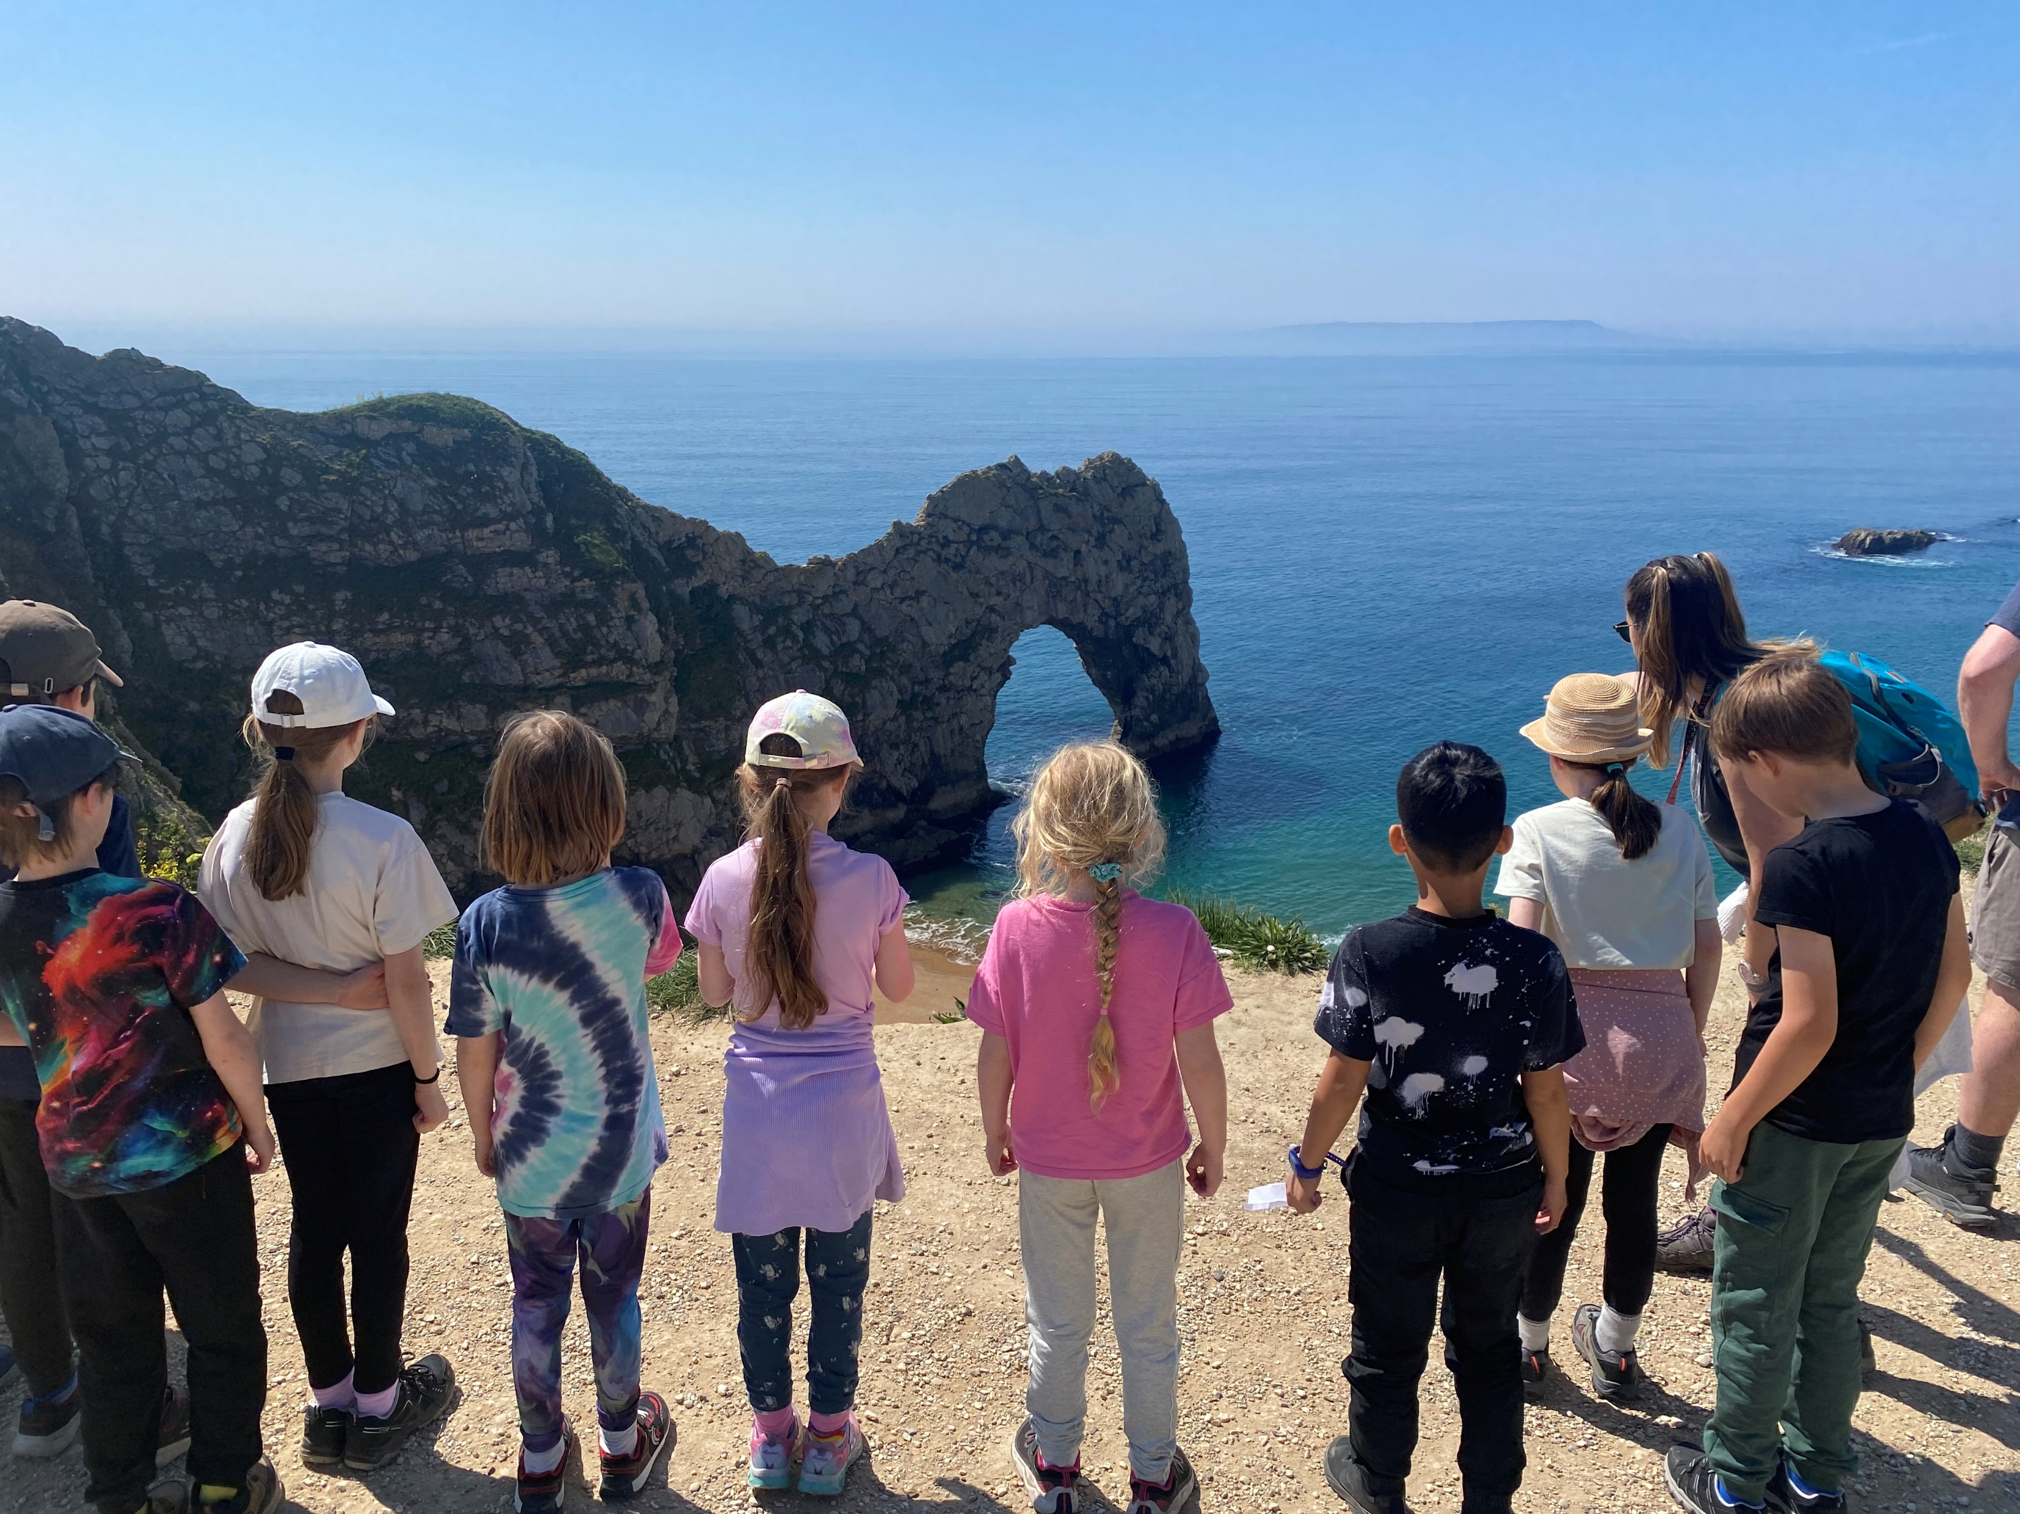
Durdle Door

Slide 5
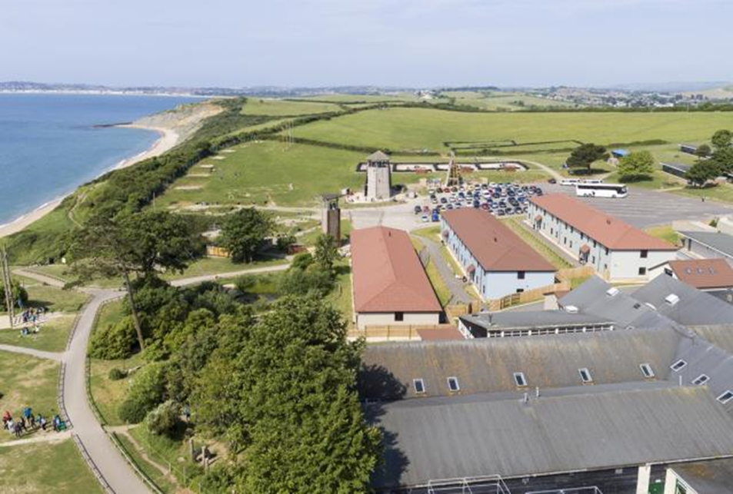
Osmington Bay PGL site
Notes:
Osmington Bay is set in 45 acres of grounds with private and secure access to a beautiful pebble beach and cliff top views. It has stunning views of Weymouth to the top of this picture as well as Portland further down from Weymouth.

Slide 6
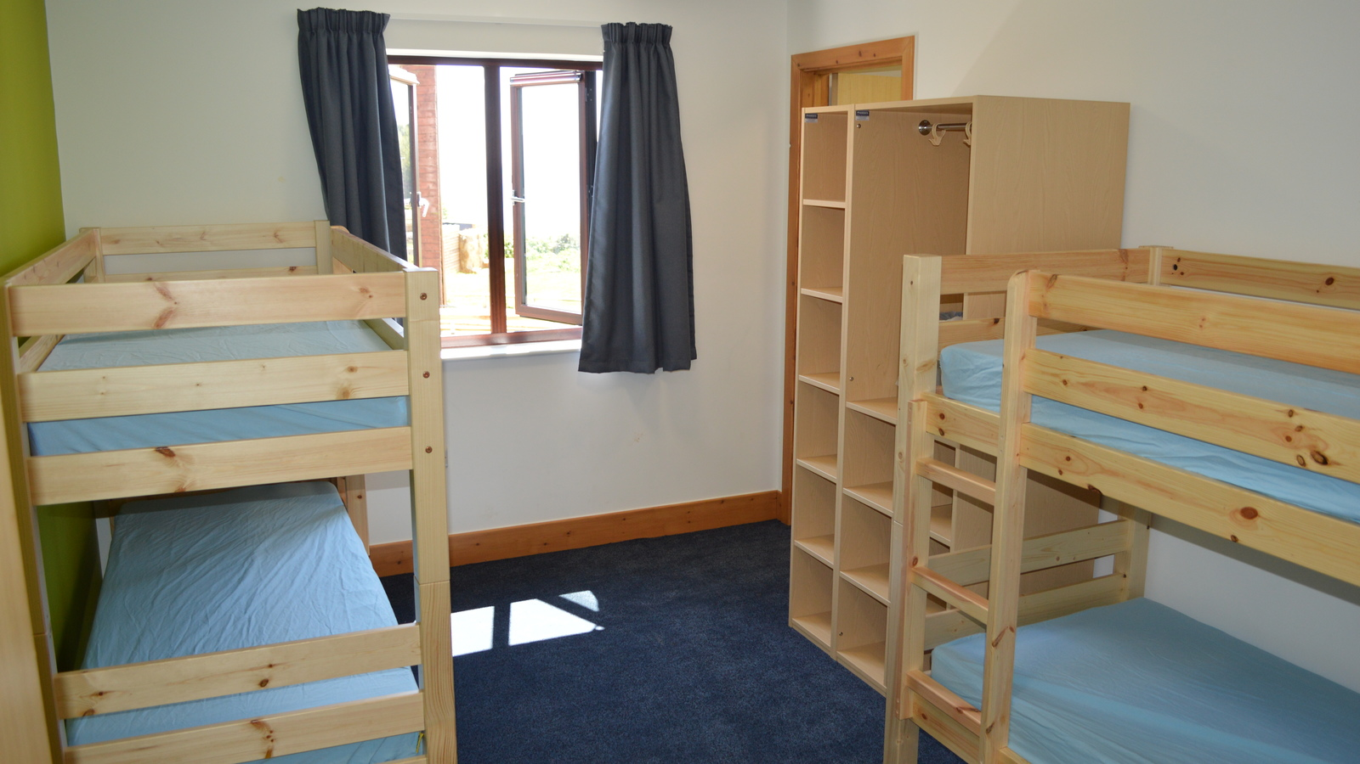
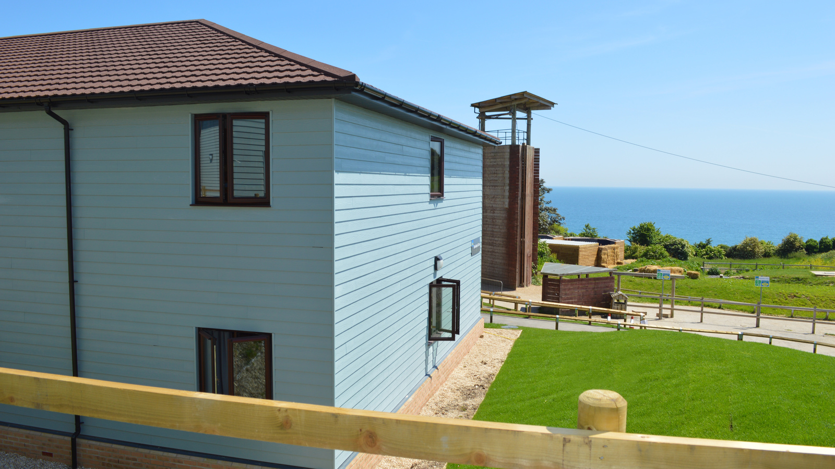
WHERE WILL I SLEEP?
Notes:
All bedrooms sleep 4 children and have an ensuite bathroom (toilet, basin and shower). There is a small wardrobe in each room, which we would like children to use to help keep their rooms tidy! All rooms have windows which lock and doors have a turn lock from the inside with quick release handle turn to unlock. Staff will have a master key that opens all bedroom doors if needed. The children will need bedding and pillows. Children will be expected to be able to put their sleeping bag away so get practising at home.

Slide 7
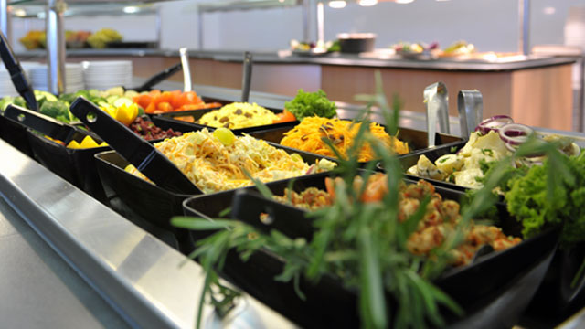
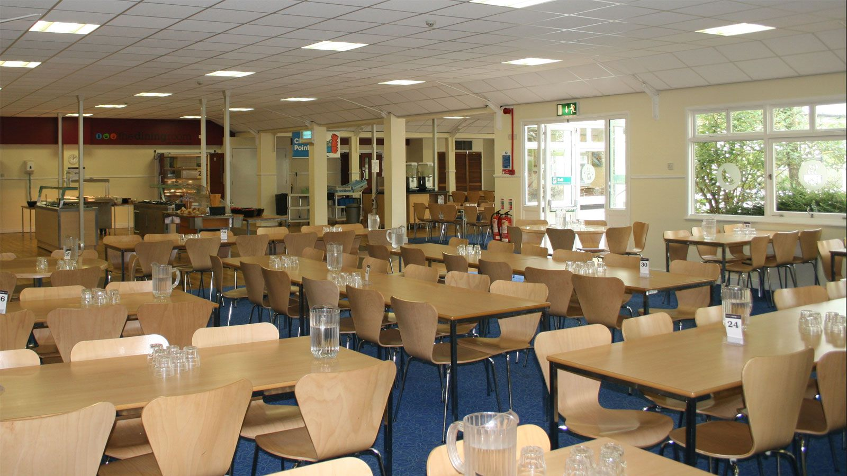

What will I eat?
https://adventureholidays.pgl.co.uk/uk-pgl-menu/
Notes:
Children are provided with a great selection each meal time so there’s always something for our more fussy eaters! They cater for all food allergies and school staff make sure that this is followed through with by way of a coloured lanyard with allergies and dietary preferences listed!
Water, squash, tea and coffee are available with all meals and children are encouraged to refill their water bottles for regular use throughout the day. There are also water fountains available around the centre.

Slide 8
Year 4 residential to Osmington Bay adventure centre
Day 1 – Monday 19th April – Continued…
On arrival at the centre, we meet our PGL reps and they send us off to our first activities.
This is followed by time to settle in to our rooms before dinner and evening activities.
Lights out is around 9 – 9:30pm.

Slide 9
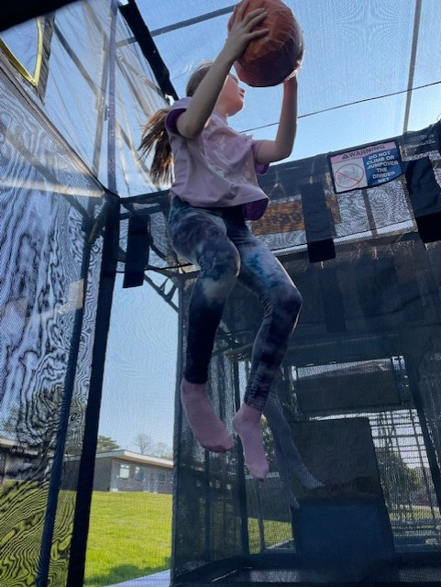
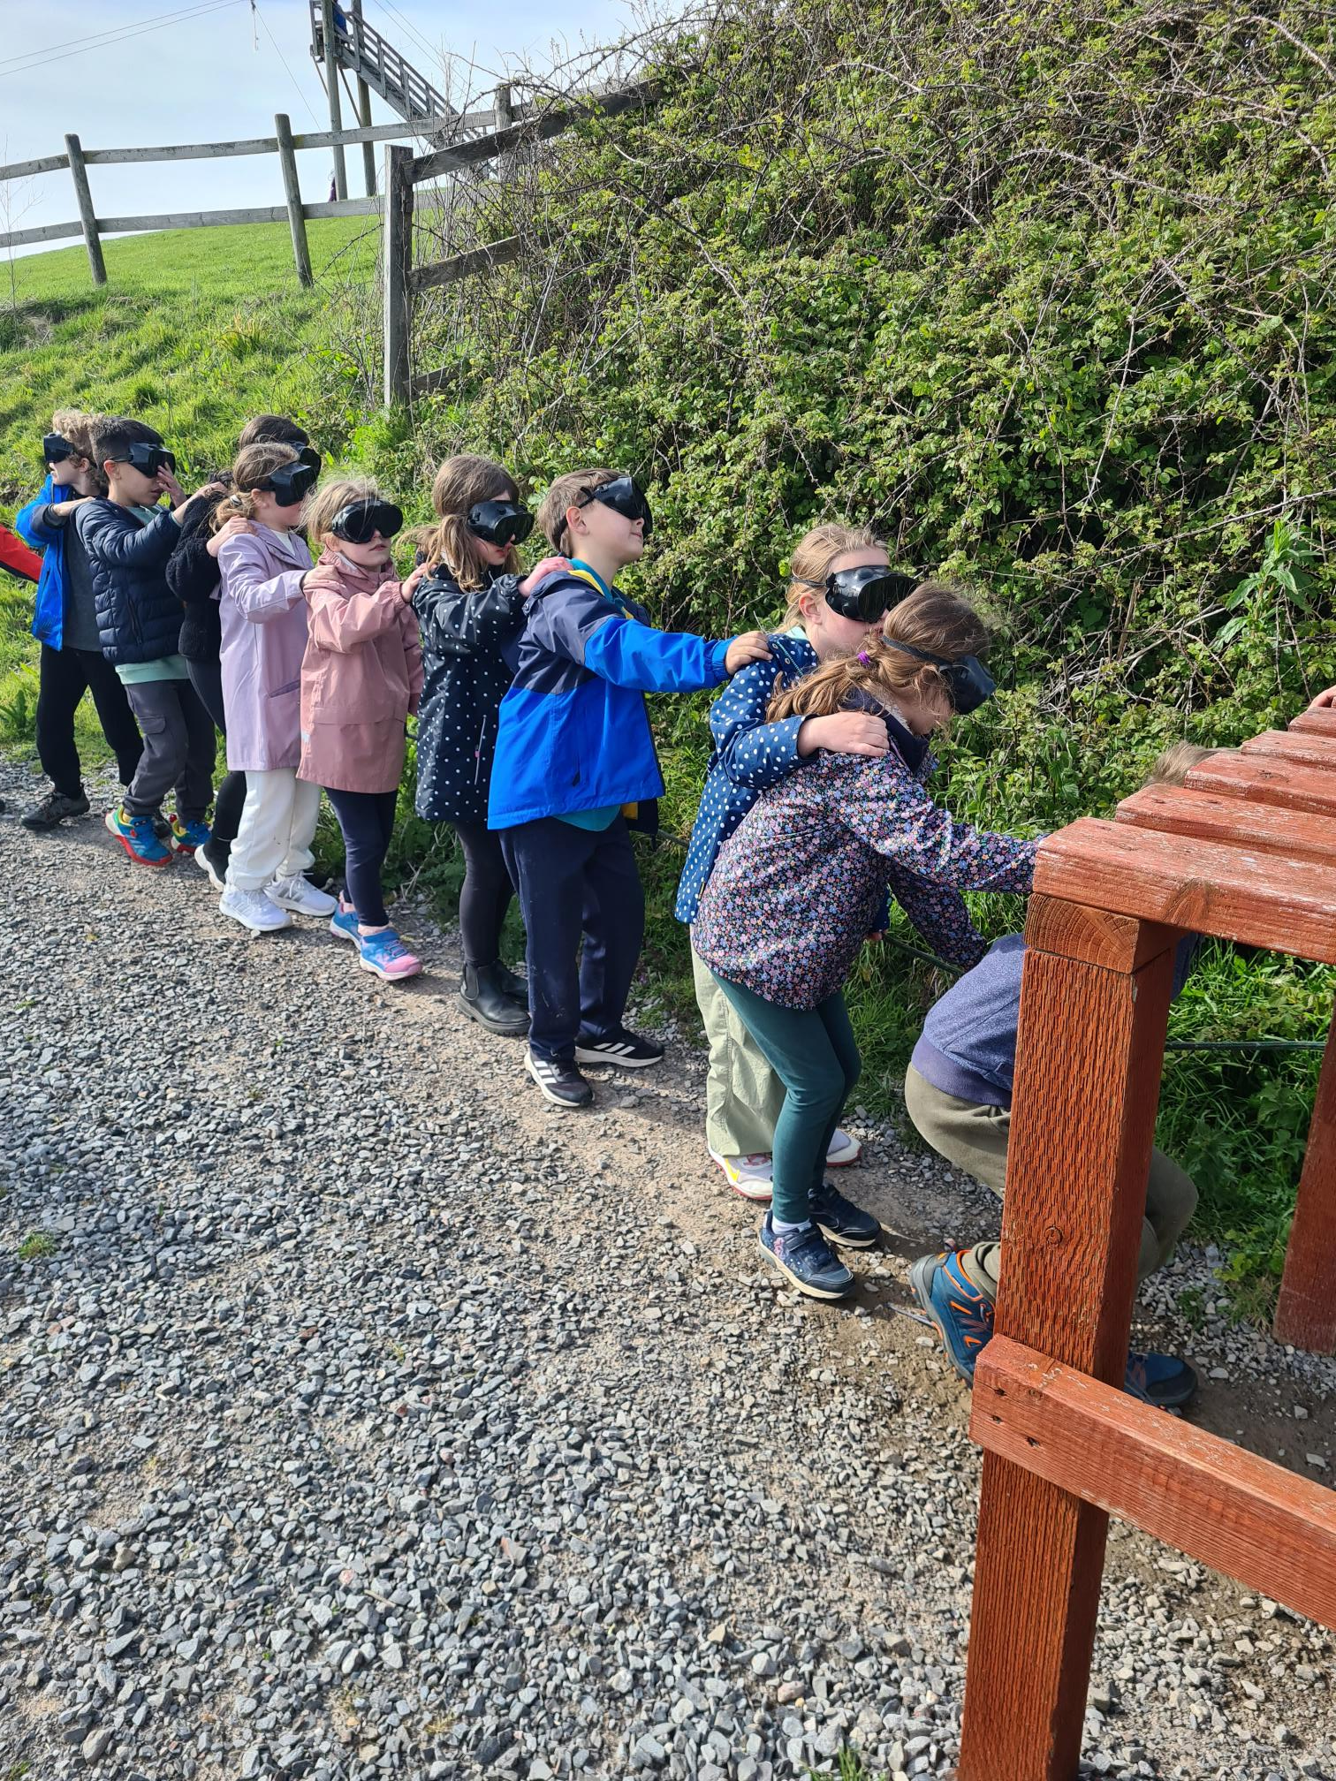
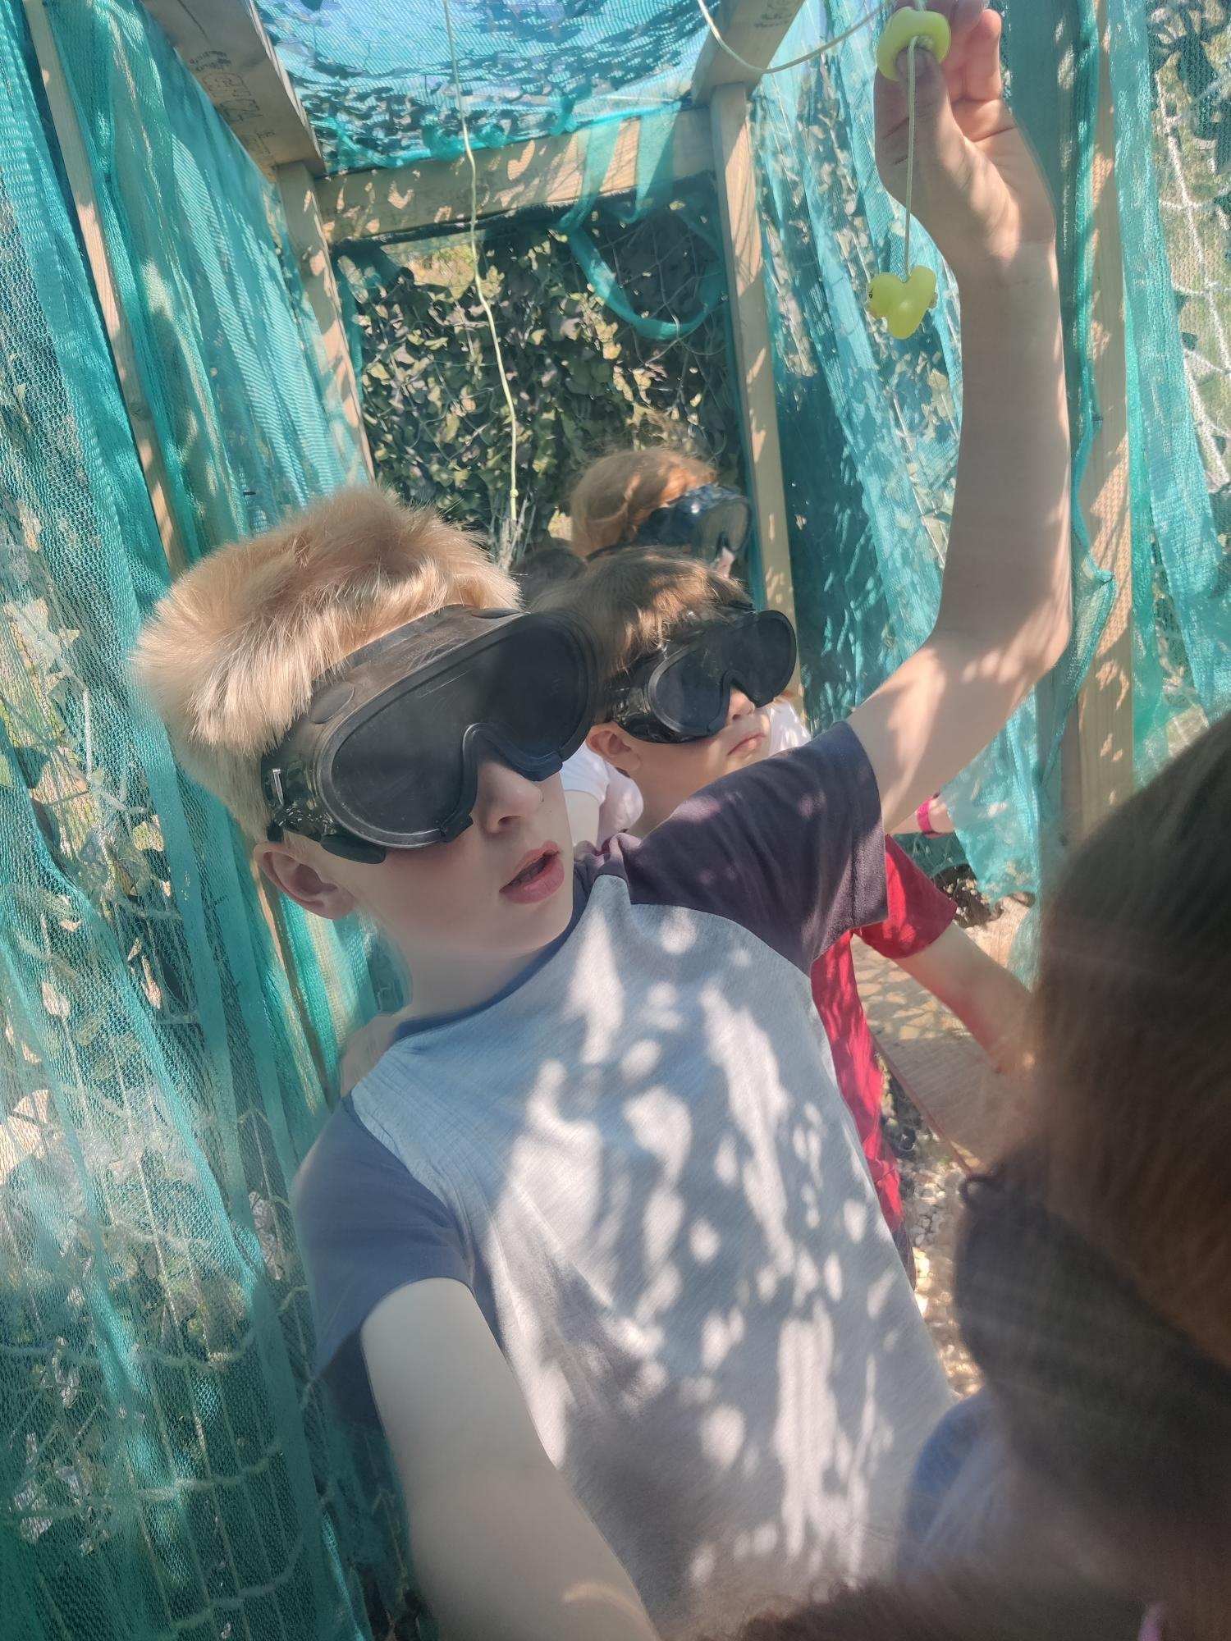
Activities…
Notes:
At the PGL site, we spend a couple of our days doing a mixture of team building activities in our working groups. This ranges from den building to orienteering. A little unfortunate that the children get really excited when seeing the high-ropes and zip wires, but we do remind them that they will have all those opportunities when they have their Year 6 residential to Manor.

Slide 10
Year 4 residential to Osmington Bay adventure centre
Day 2 – Tuesday 20th April –
We have a full day of activities at the centre. Our day includes a cooked breakfast and lunch!

Slide 11
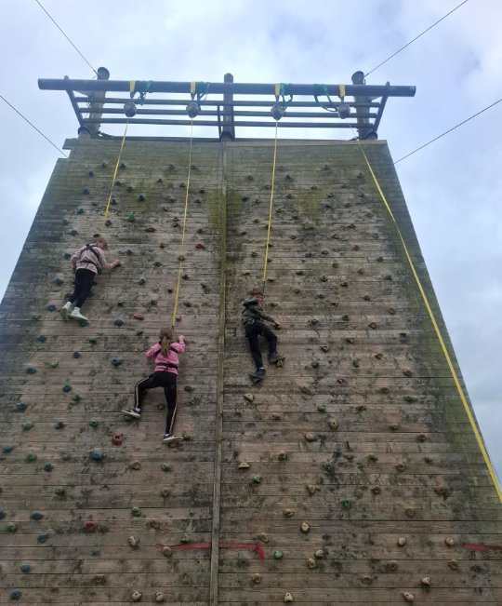
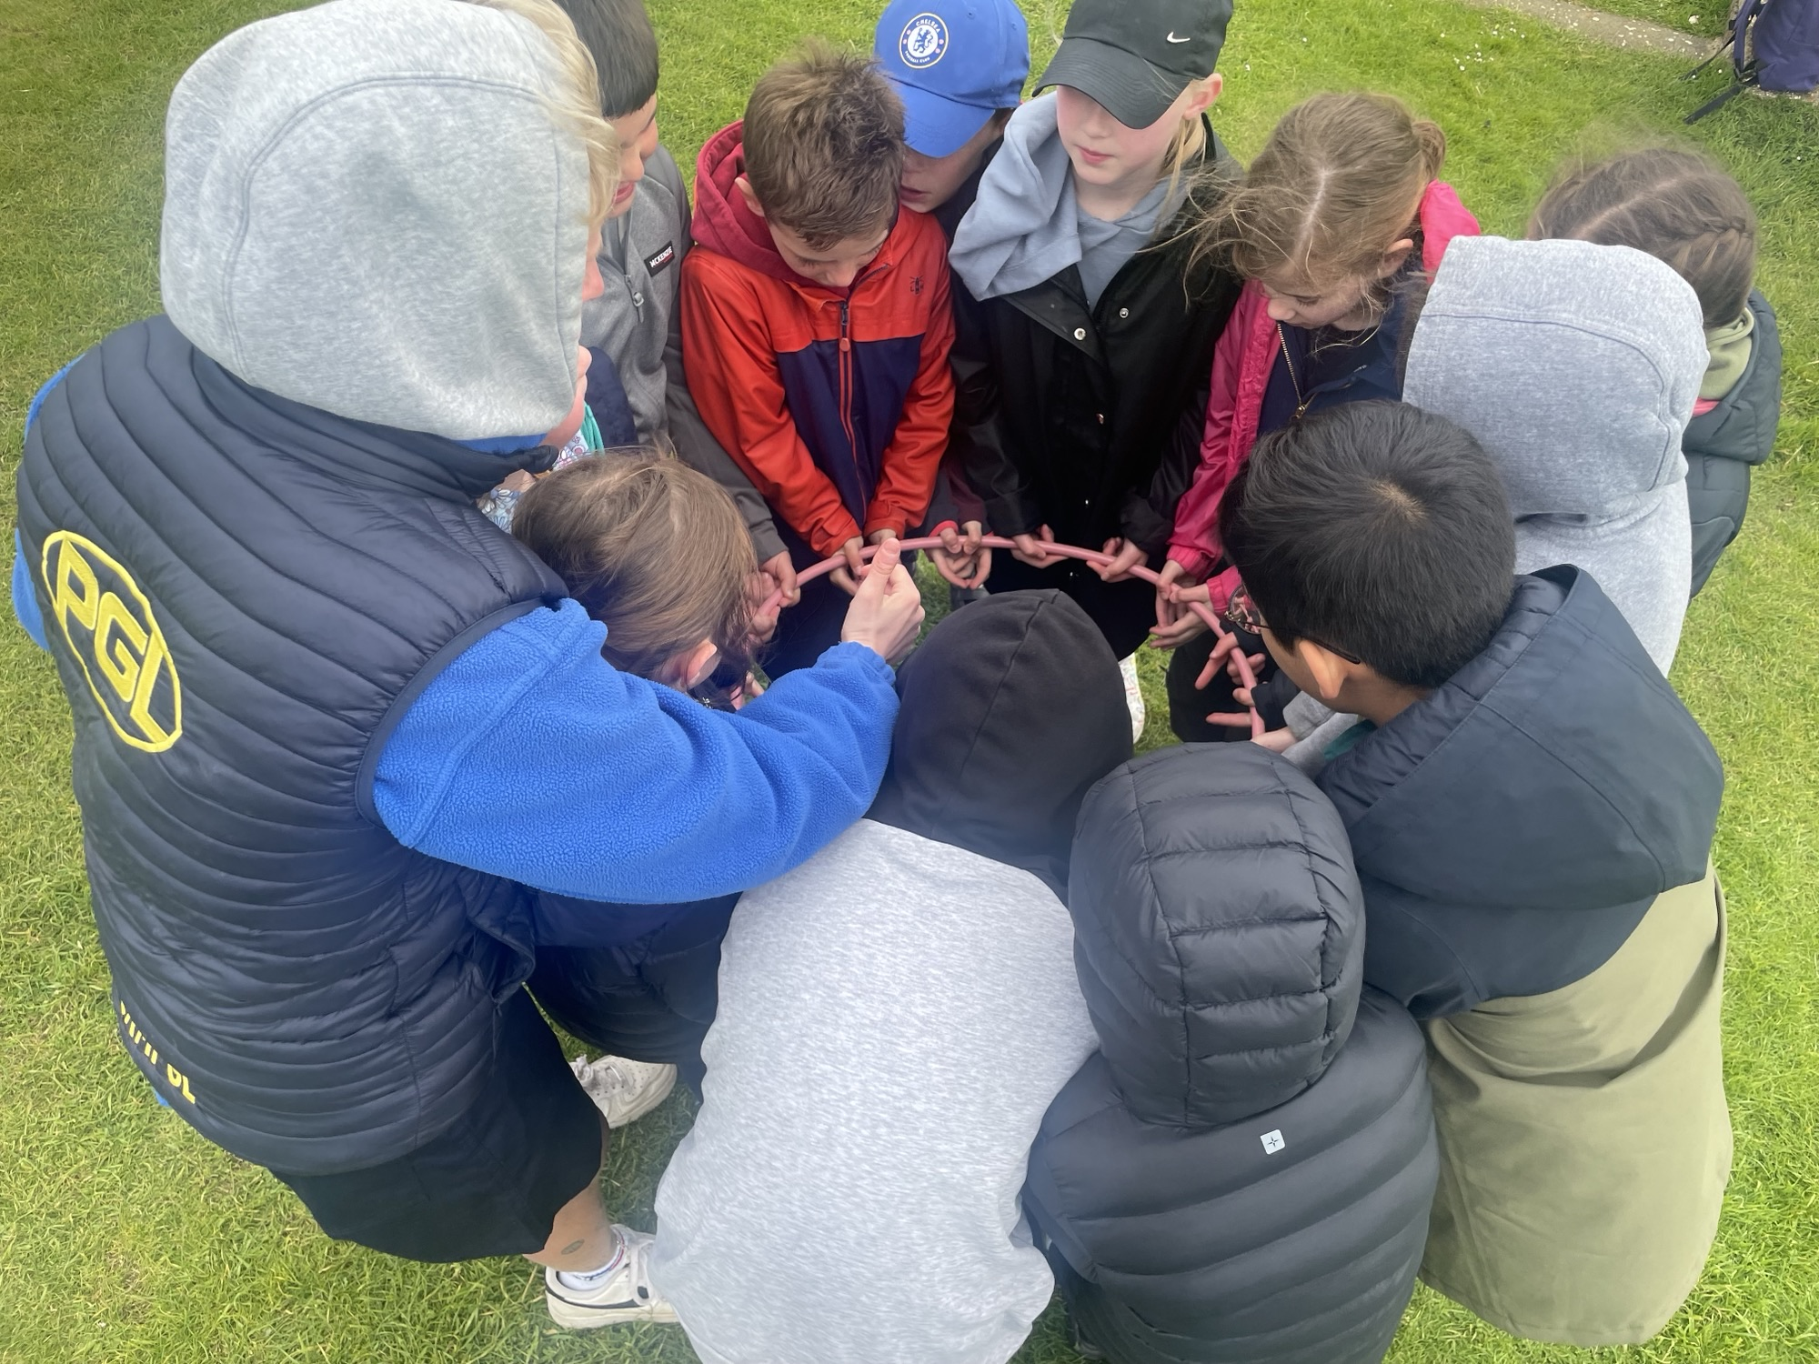

Slide 12
Year 4 residential to Osmington Bay adventure centre
Day 2 – Tuesday 20th April –
After dinner there will be more fun and games before bed.
Lights out will be around 9pm.
Night two is usually much quieter than night one!

Slide 13
Year 4 residential to Osmington Bay adventure centre
Day 3 – Wednesday 21st April–
On the last day we will be up and packed before breakfast. Then we head off to another round of activities. After another cooked lunch, we board the coaches and head for home. We will arrive back at Heatherside around 5pm.

Slide 14
Year 4 residential to Osmington Bay adventure centre
Activites –
Aeroball, Archery, Orienteering, Team Games, Survival skills, Climbing, Campfire fun and more!
Notes:
We leave early on the 24th and will get back later in the afternoon of the 26th

Slide 15


Suggested kit list – All items must be named
Rucksack with comfortable straps (Small, but big enough to fit coat/ water bottle / packed lunch)
2 Water bottles (filled with water for the outward journey)
Sunscreen/sunglasses
Small teddy bear / soft toy
Note pad and pencils
Book to read
Card games
Torch
1 pair of comfortable, closed Walking shoes;
1 pair trainers / indoor shoes;
4 pairs underwear;
4 T-shirts;
2 jumpers/ fleeces;
3 pairs of trousers/leggings/tracksuit (not jeans);
4 pairs above ankle socks;
Hat / cap;
Waterproof coat; not too bulky
Toiletries (toothbrush and toothpaste, soap/body wash, face-cloth, hairbrush / comb, hair-bands and clips)
1 Towel
Night wear such as pyjamas
Hand sanitiser
Tissues
Not to be taken
Mobile phones
Any electrical toys / MP3s
Aerosol cans
Sweets / food products (other than packed lunch for day 1!)
Pocket money
Notes:
We have this suggested kit list available for you to take home with you today and it will be available on our website with this PowerPoint presentation to refer back to. It is VITAL that all belongings are named as, with untidy rooms, come a manner of all sorts being left behind. Please make sure your child is able to pack their own suitcases as they will have to do this when they come back.

Slide 16
Medication
During our final Parents Briefing in March, we will provide information and details about when and how Medication is to be brought in.
During the trip two members of school staff will be in charge of administering and recording medications.
Notes:
Yes, we will take all necessary medication with us. We will give you more details about how to go about this in the Spring Term along with medication forms and kit lists.

Slide 17
Cost? –
Approx £300 but this is dependent on numbers attending and the cost of the coaches.
A deposit of £45 to be made by Friday 25th September to secure places. A further £105 to be paid before the start of December.
For those children in receipt of pupil premium, please chat with the office about what you are entitled to or see the updated information previously sent. If insufficient contributions received then this trip may have to be cancelled.
Notes:
We fully appreciate that the economic climate has changed and this means that parents may have to change their minds about sending children on the residential. This cost is based on the majority of our Year 4 children going. If less children go on the residential, it will mean that costs will go up. We totally acknowledge that this is a big ask! Remember that our trip is educational, covering some of our Geography and PSHE topics, so those staying behind will need to complete these aspects while others are away. You are able to pay in instalments.

