Slide 1
Year Three Curriculum
A short guide to how to help your child at home

Slide 2
Getting to know your child
Reading, phonics and Maths assessments
Tailoring the curriculum to suit each child
Interventions to help address any missed areas

Slide 3

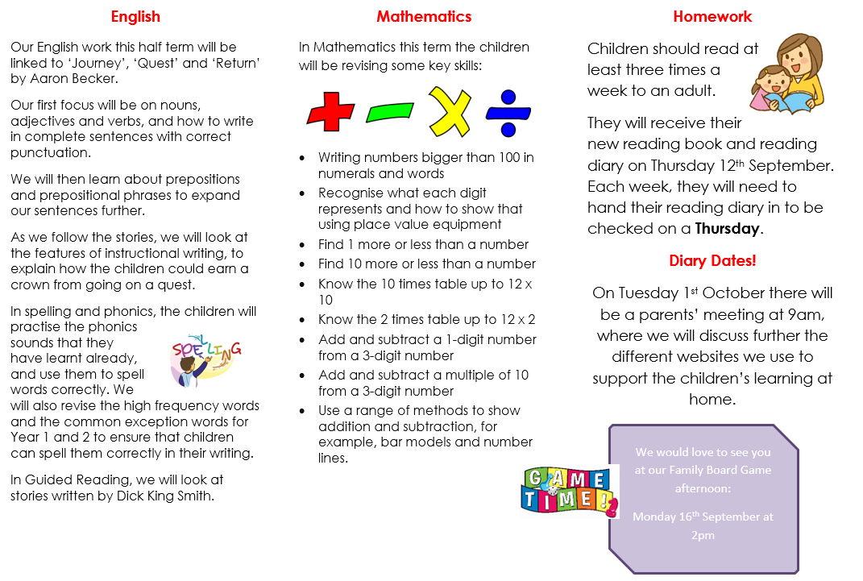
Curriculum Overviews
These are emailed to you every half term, and can also be viewed on the school website.
Separate lessons, but links between them.

Slide 4

Reading
Reading underpins everything that we do!
How we support your child: Listening to them read, phonics, Guided Reading, English lessons
No child should struggle to access the curriculum even if they find reading a challenge

Slide 5

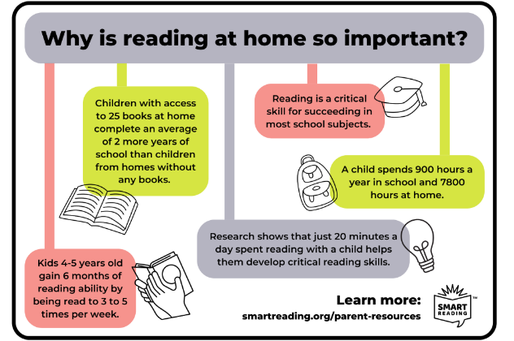
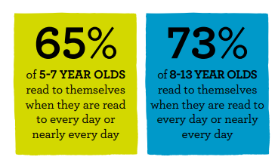
Why your child should read with an adult

Slide 6
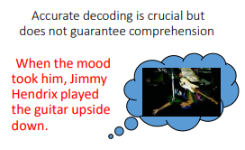
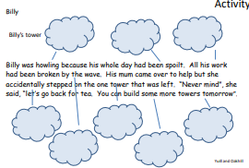
Reading isn’t just decoding.
We want readers who:
Ask questions as they read (what sort of star?)
Use their background knowledge to help them understand what they are reading (tower…wave…work… beach!)
Discuss unfamiliar words
Talk about the text
…The photograph of the newly discovered star was on the front page…

Slide 7
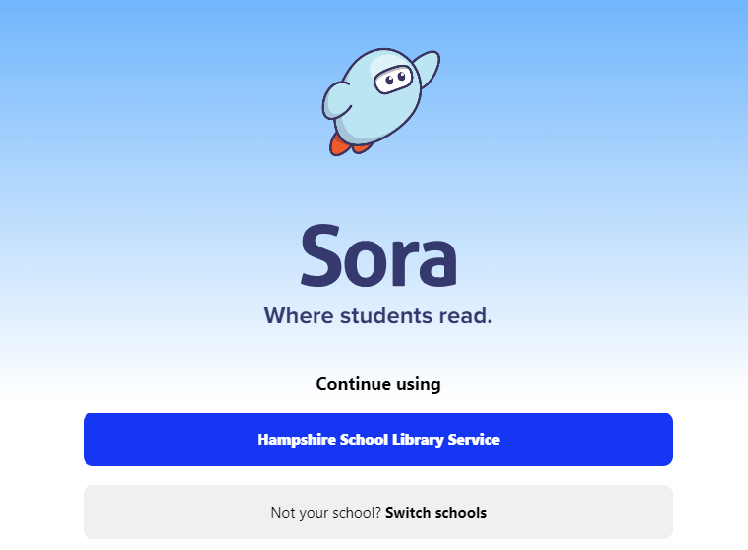
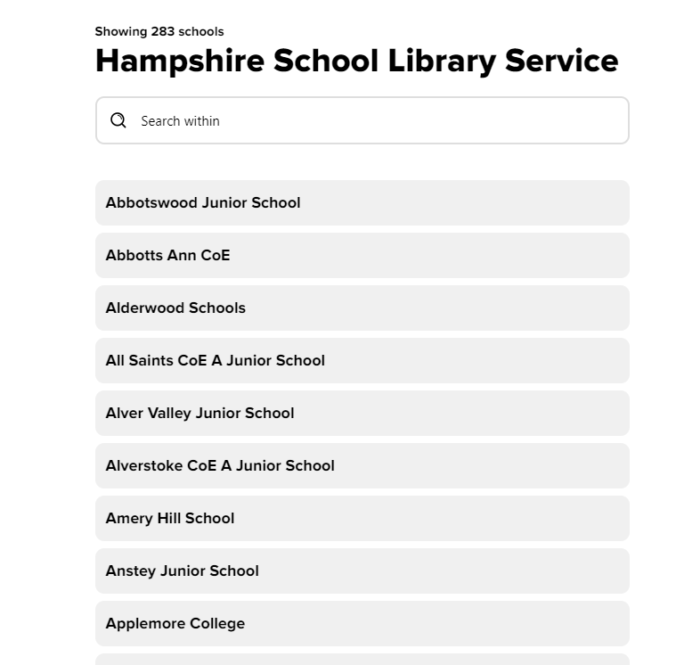
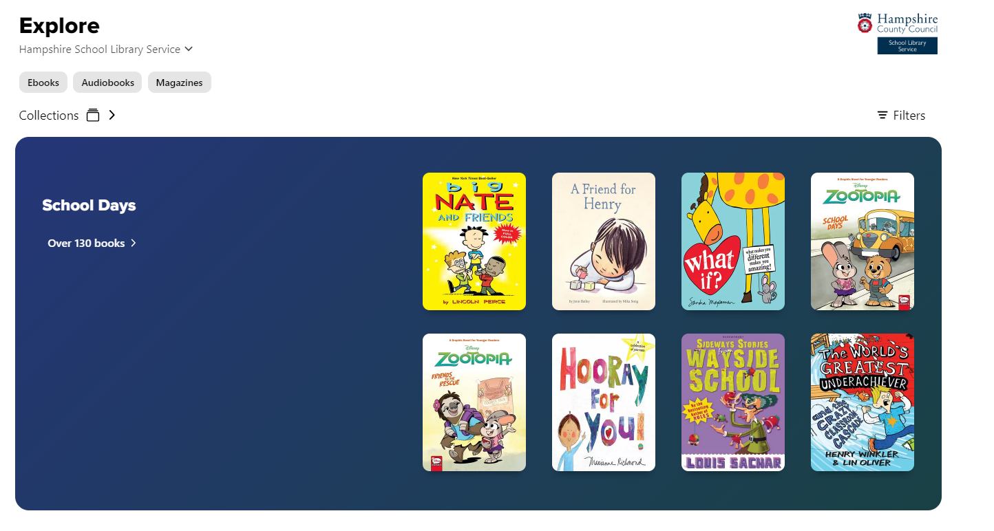
A fantastic resource for borrowing books online
Passwords should be lower case rather than uppercase as it is on the password sheet

Slide 8


Times Tables
Superhero challenges
Fortnightly times table tests
Regular practice in class using different methods

Slide 9
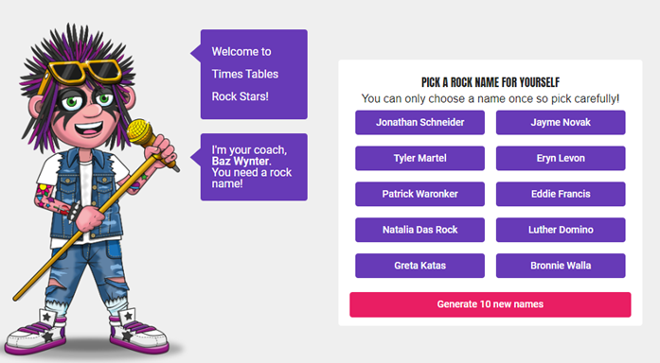
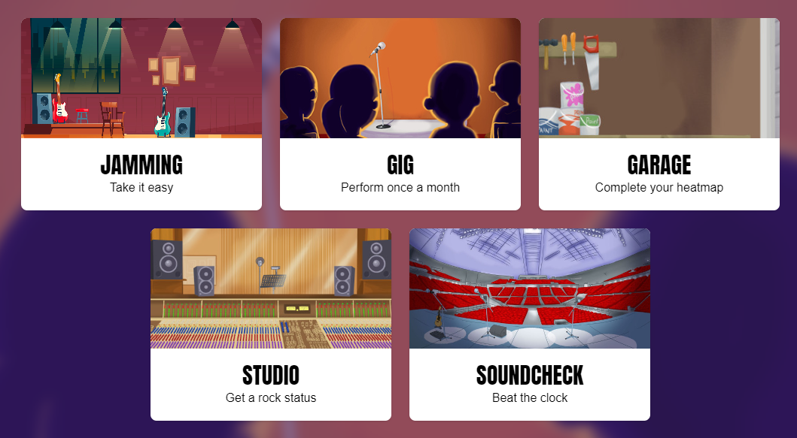

Log in by choosing your school name, and then username and password
Pick your rock star name!
Choose between single player or multiplayer
Different ways to play and earn coins

Slide 10

Spelling
One focus studied in school each week
Can be supported at home through suggested activities
No weekly spelling test

Slide 11
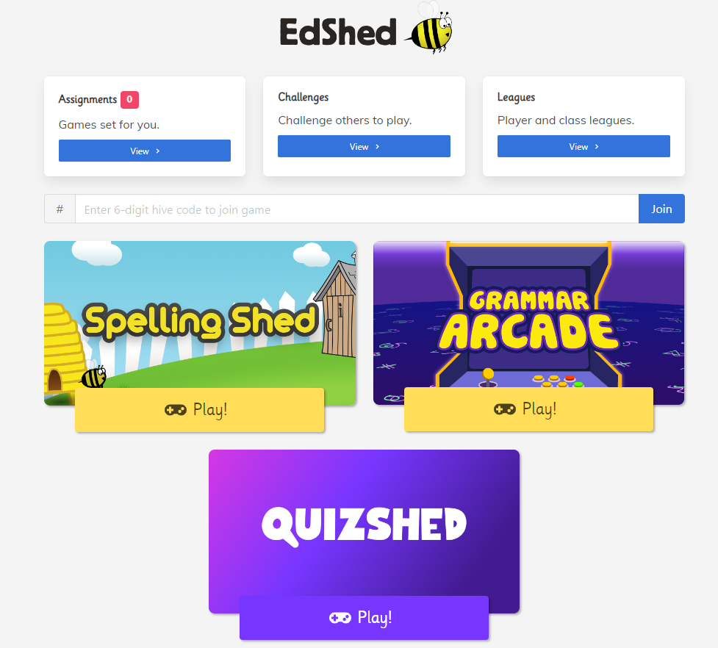
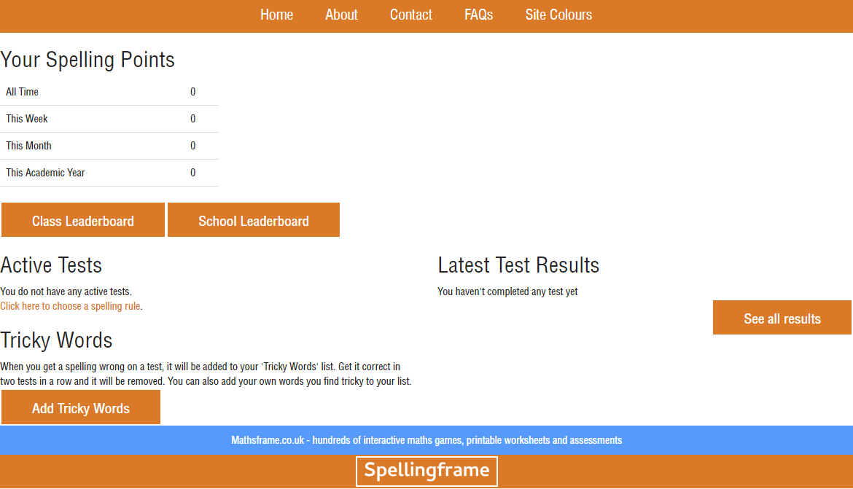
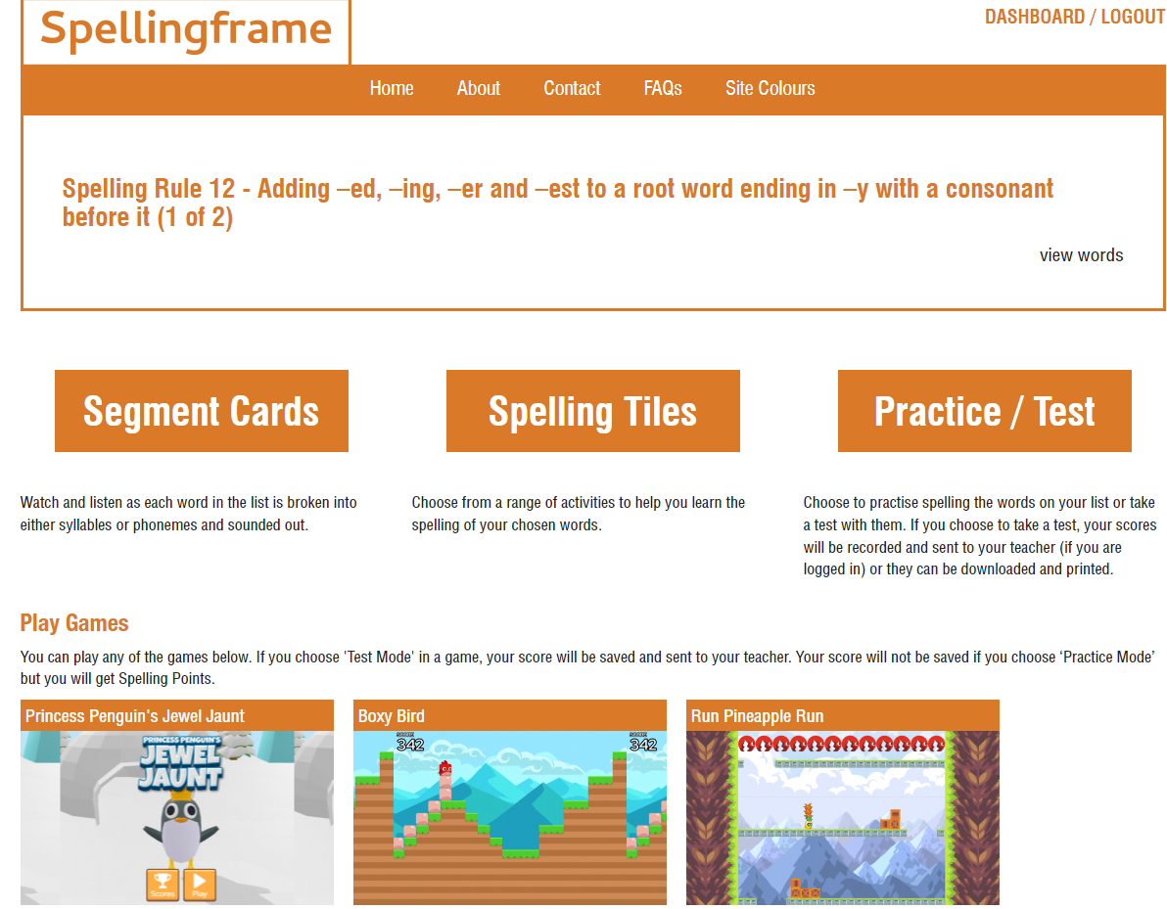
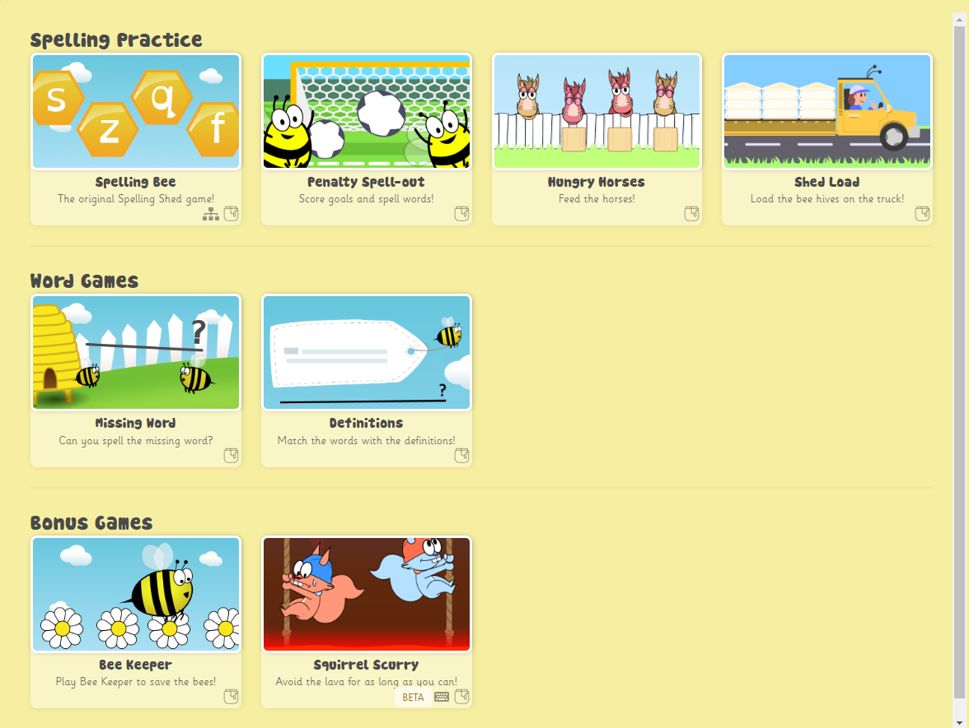
Spelling

Slide 12
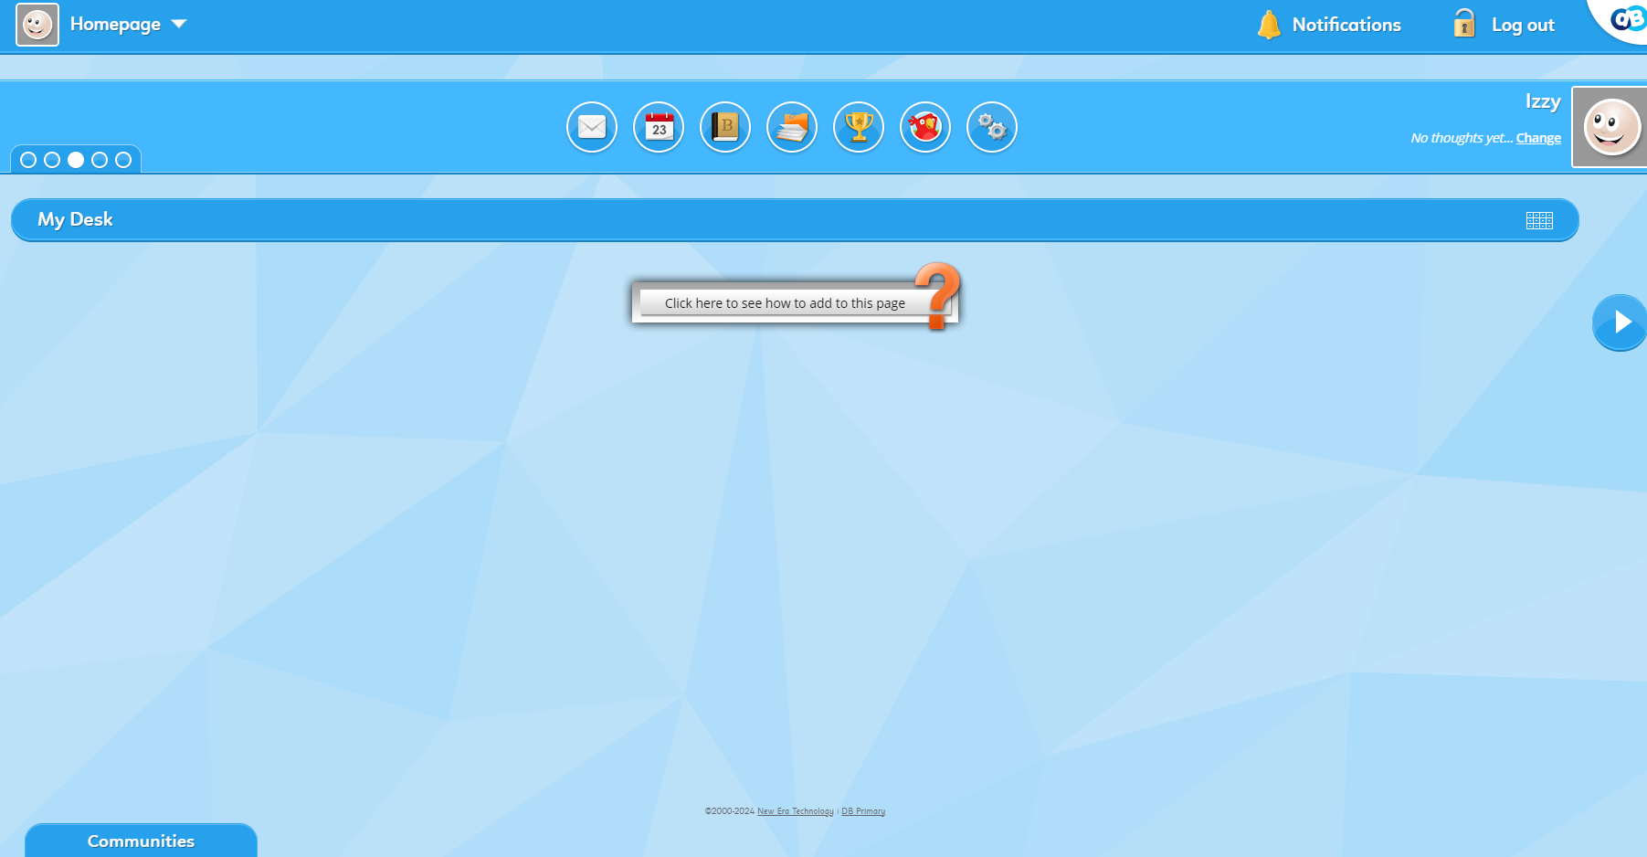
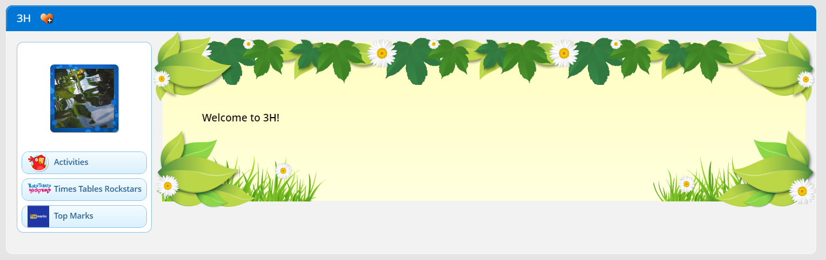
DB Primary
Spelling focus shared on here every week
Whole school/year group homework set later in the year

Slide 13
Any further questions?

